Slide 1
Download Rapido

Slide 2

Arshad Husain
Creator

Slide 3




Safety Tip’s
For journey

Slide 4
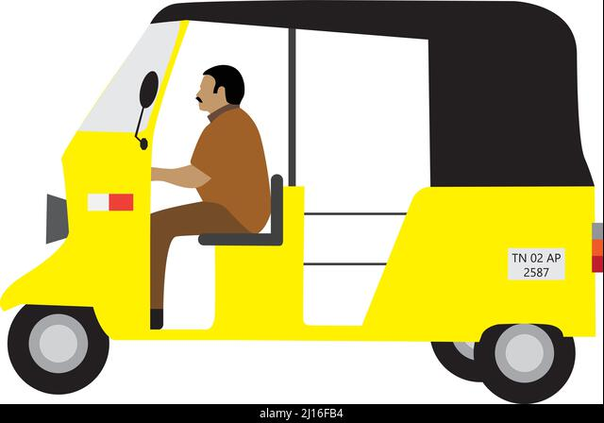

Slide 5






Emails
Blogging
Facebook
Instagram
Twitter
YouTube

Slide 6

Read more here

Slide 8
25M
Downloads

Slide 9

25M
Downloads
10M+
Customers

Slide 10


Slide 11
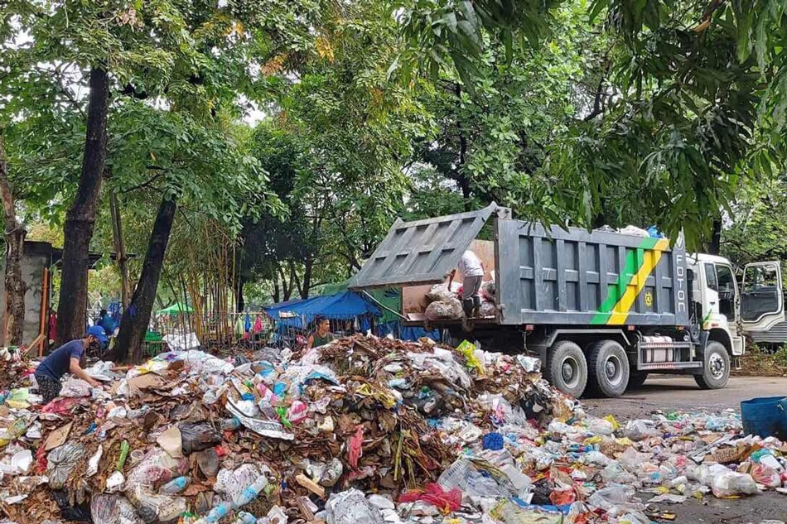

Slide 12
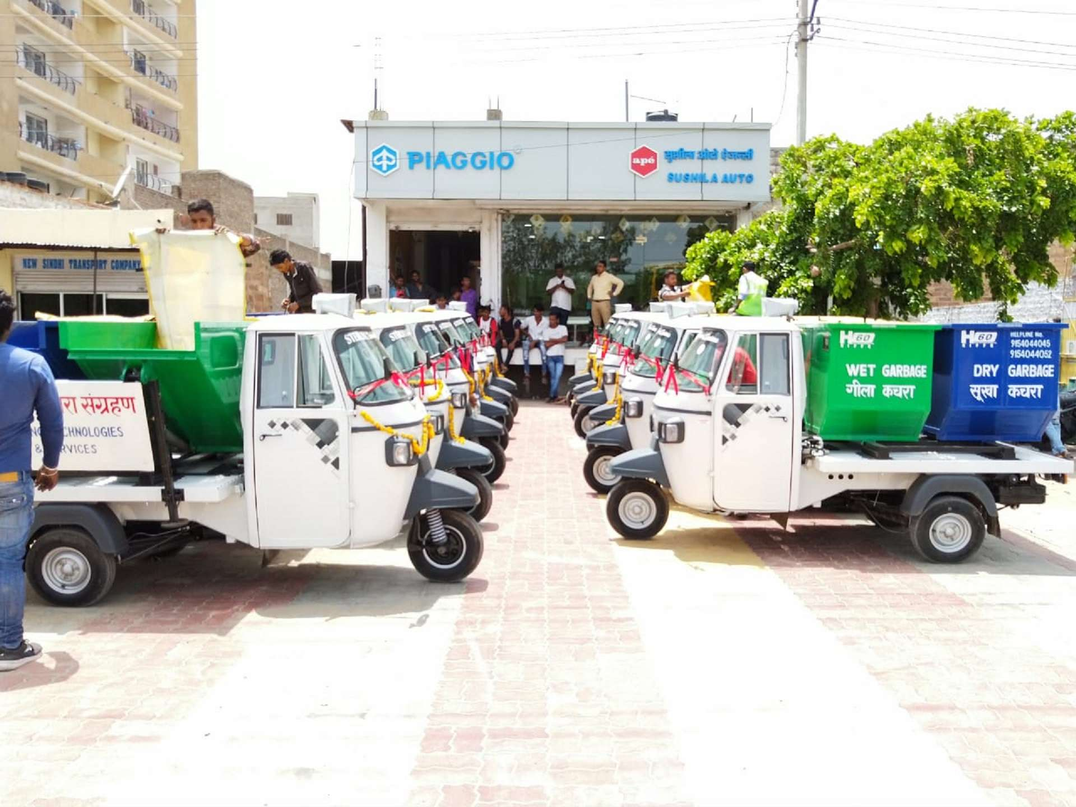

Slide 13


Slide 14
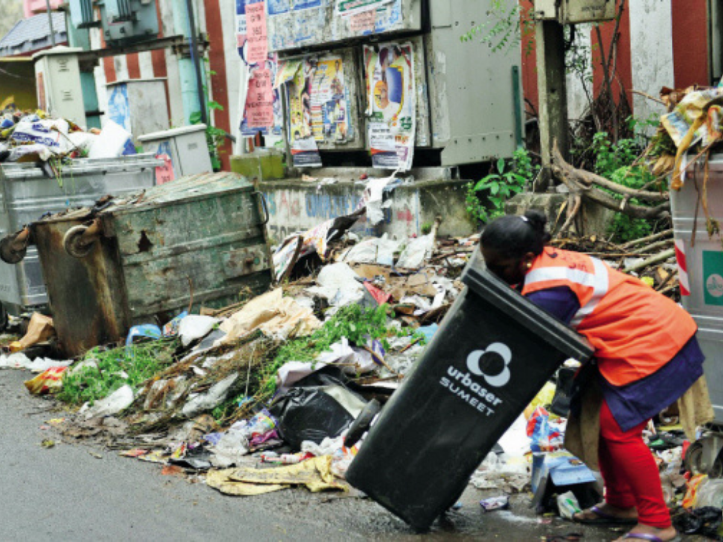

Slide 15


Slide 16




🆆🅰🆂🆃🅴
solution

Slide 17


Slide 18




